Slide 1
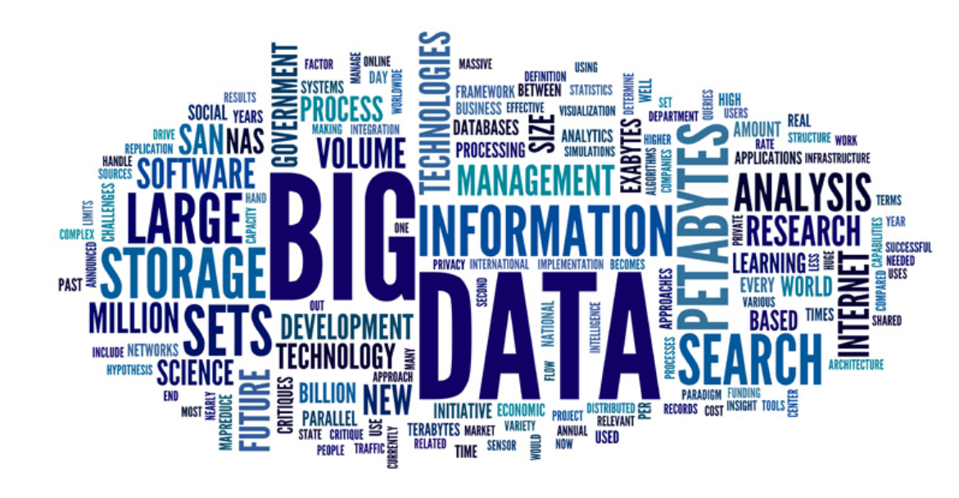
Big-Data Analytics
Lecture-1: Fundamentals of Big Data

Slide 2
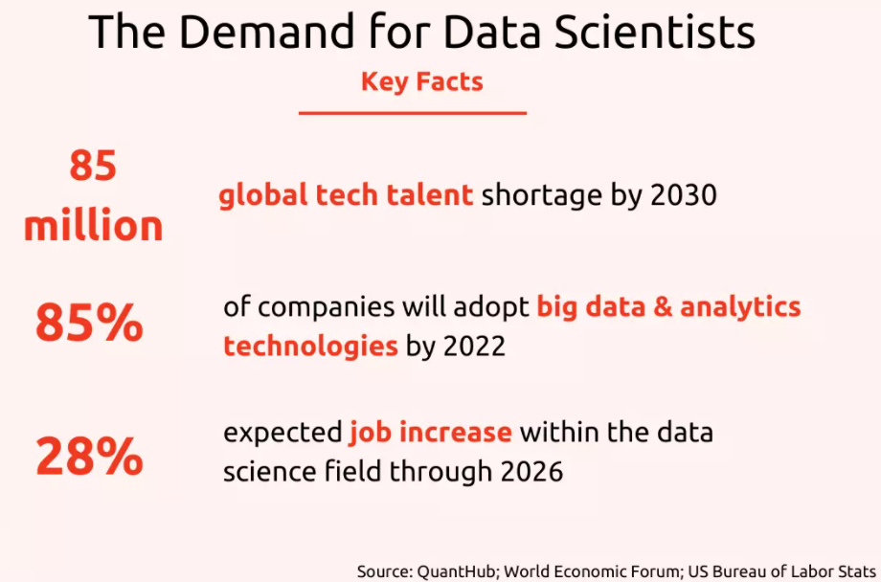

Slide 3
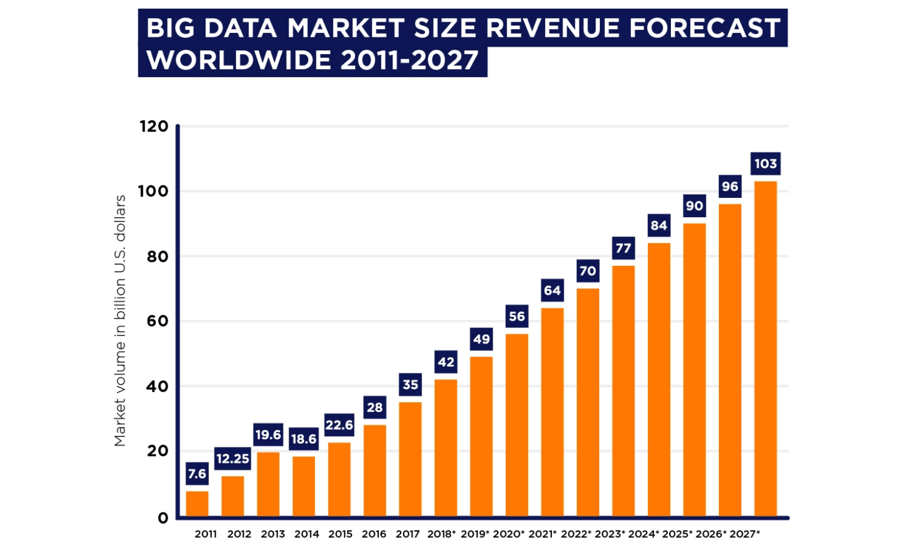

Slide 4
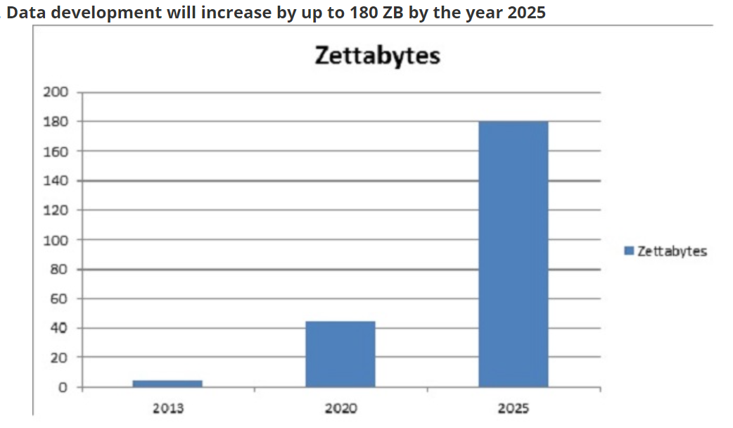

Slide 5
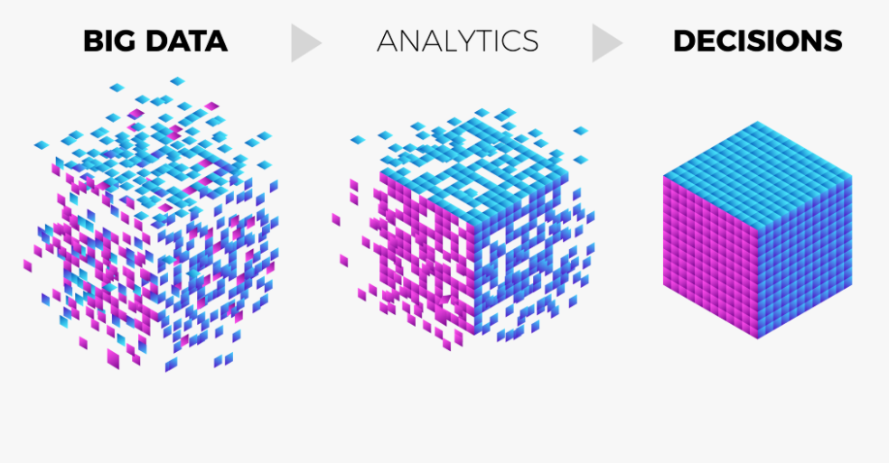
Extremely large data sets that may be analyzed computationally to reveal patterns, trends, and associations, especially relating to human behavior and interactions.

Slide 6
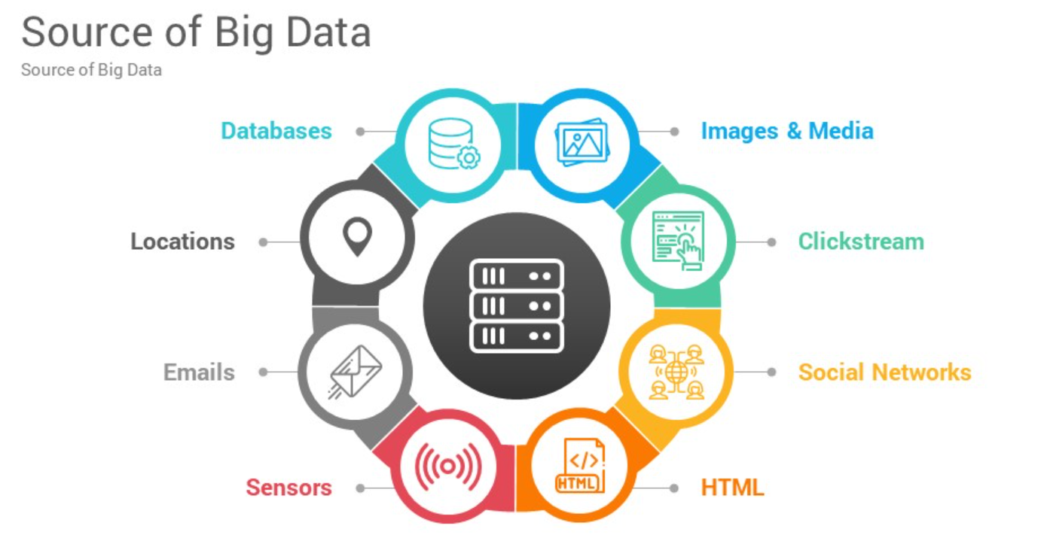

Slide 7
Quick Quiz?
Big data is-
A data science software
A data analysis software
Both of them
None of them

Slide 8
Quick Quiz?
Big data means-
Very large amount of data
The data which has some importance to a business
Both of them
None of them

Slide 9
Big Data Use-Cases
After learning what is analytics. Let us now discuss various use cases of Big data. Below are some of the Big data use cases from different domains:
Netflix Uses Big Data to Improve Customer Experience
Promotion and campaign analysis by Sears Holding
Sentiment analysis
Customer Churn analysis
Predictive analysis
Real-time ad matching and serving

Slide 10
The results obtained through the processing of Big Data can lead to a wide range of insights and benefits, such as:
operational optimization
actionable intelligence
identification of new markets
accurate predictions
fault and fraud detection
more detailed records
improved decision-making
scientific discoveries

Slide 11
Big Data Technologies
There are lots of technologies to solve the problem of Big data Storage and processing. Such technologies are Apache Hadoop, Apache Spark, Apache Kafka, etc. Let’s take an overview of these technologies in one by one-

Slide 12
i. Apache Hadoop
Big data is creating a Big impact on industries today. Therefore the world’s 50% of the data has already been moved to Hadoop.
It is predicted that by 2017, more than 75% of the world’s data will be moved to Hadoop and this technology will be the most demanding in the market as it is now.

Slide 13
ii. Apache Spark
Further enhancement of this technology has led to an evolution of Apache Spark – lightning fast and general purpose computation engine for large-scale processing. It can process the data up to 100 times faster than MapReduce.

Slide 14
Apache Kafka
Apache Kafka is another addition to this Big data Ecosystem which is a high throughput distributed messaging system frequently used with Hadoop.
IT organizations have started considering Big data initiative for managing their data in a better manner, visualizing this data, gaining insights of this data as and when required and finding new business opportunities to accelerate their business growth.
Every CIO wants to transform his company, enhance their business models and identify potential revenue sources whether he being from the telecom domain, banking domain, retail or healthcare domain etc.

Slide 15
What are the best Big Data Tools?
Here is the list of top 10 big data tools –
Apache Hadoop
Apache Spark
Flink
Apache Storm
Apache Cassandra
MongoDB
Kafka
Tableau
RapidMiner
R Programming

Slide 16
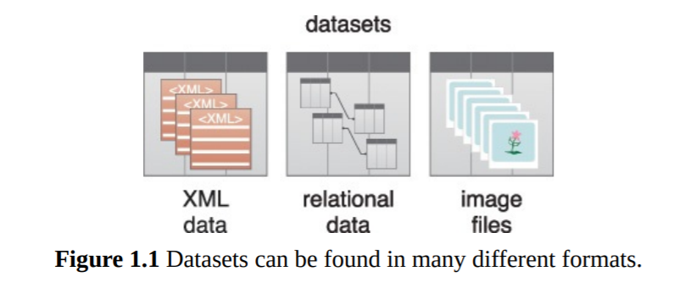
Datasets
Collections or groups of related data are generally referred to as datasets. Each group or dataset member (datum) shares the same set of attributes or properties as others in the same dataset.
Some examples of datasets are:
• tweets stored in a flat file
• a collection of image files in a directory
• an extract of rows from a database table stored in a CSV formatted file
• historical weather observations that are stored as XML files

Slide 17
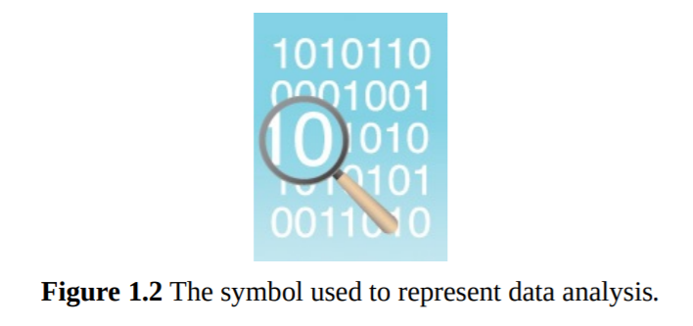
Data Analysis
Data analysis is the process of examining data to find facts, relationships, patterns, insights and/or trends.
The overall goal of data analysis is to support better decision making.
Ex: “how the number of ice cream cones sold is related to the daily temperature?”

Slide 18
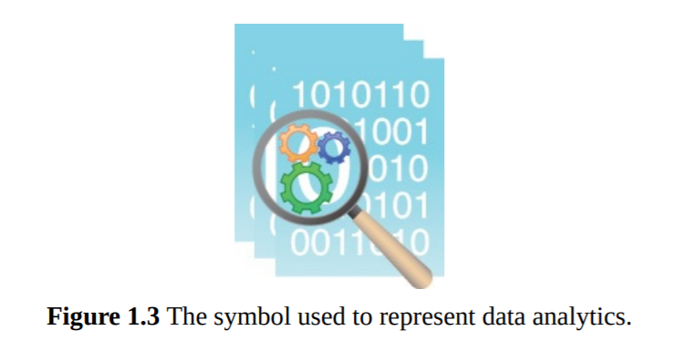
Data Analytics
Data analytics is a discipline that includes the management of the complete data lifecycle, which encompasses collecting, cleansing, organizing, storing, analyzing and governing data.
Big Data Analytics
The Big Data analytics lifecycle generally involves identifying, procuring, preparing and analyzing large amounts of raw, unstructured data to extract meaningful information that can serve as an input for identifying patterns, enriching existing enterprise data and performing large-scale searches.

Slide 19
Different kinds of organizations use data analytics tools and techniques in different ways. Take, for example, these three sectors:
• In business-oriented environments, data analytics results can lower operational costs and facilitate strategic decision-making.
• In the scientific domain, data analytics can help identify the cause of a phenomenon to improve the accuracy of predictions.
• In service-based environments like public sector organizations, data analytics can help strengthen the focus on delivering high-quality services by driving down costs.

Slide 20
Quick Quiz
For large scale processing in big data which one is more suitable?
Spark
B. Kafka
C. Mapreduce
D. hadoop

Slide 21
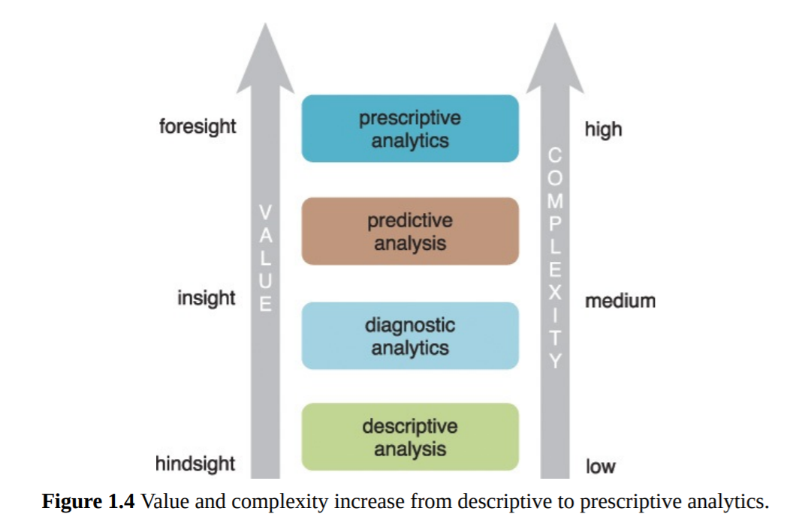
General categories of analytics
• Descriptive analytics
• Diagnostic analytics
• Predictive analytics
• Prescriptive analytics

Slide 22
Descriptive Analytics
Descriptive analytics are carried out to answer questions about events that have already occurred. This form of analytics contextualizes data to generate information.
Sample questions can include:
• What was the sales volume over the past 12 months?
• What is the number of support calls received as categorized by severity and geographic location?
• What is the monthly commission earned by each sales agent?
It is estimated that 80% of generated analytics results are descriptive in nature.
Value wise, descriptive analytics provide the least worth and require a relatively basic skill set.

Slide 23
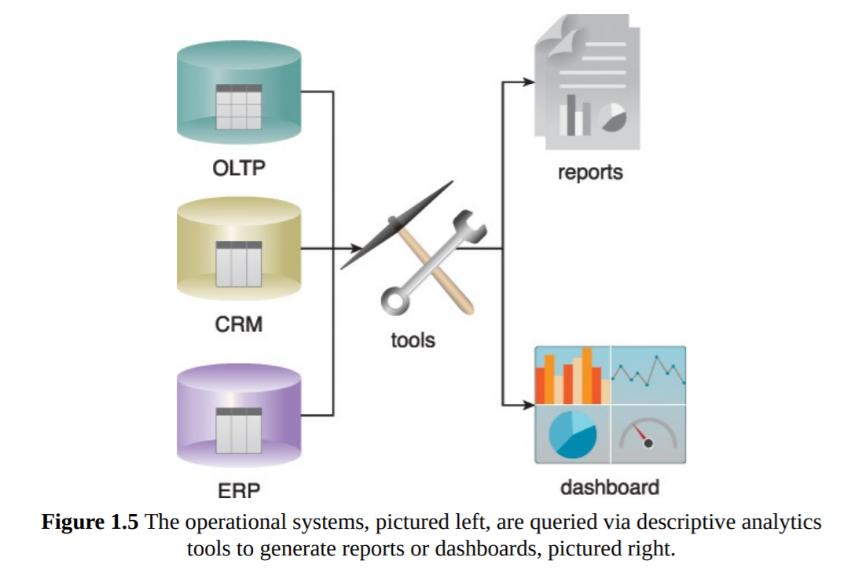
Descriptive analytics are often carried out via ad-hoc reporting or dashboards

Slide 24
Diagnostic Analytics
Diagnostic Analytics Diagnostic analytics aim to determine the cause of a phenomenon that occurred in the past using questions that focus on the reason behind the event.
Such questions include:
• Why were Q2 sales less than Q1 sales?
• Why have there been more support calls originating from the Eastern region than from the Western region?
• Why was there an increase in patient re-admission rates over the past three months? ind the event.
Diagnostic analytics results are viewed via interactive visualization tools that enable users to identify trends and patterns.

Slide 25
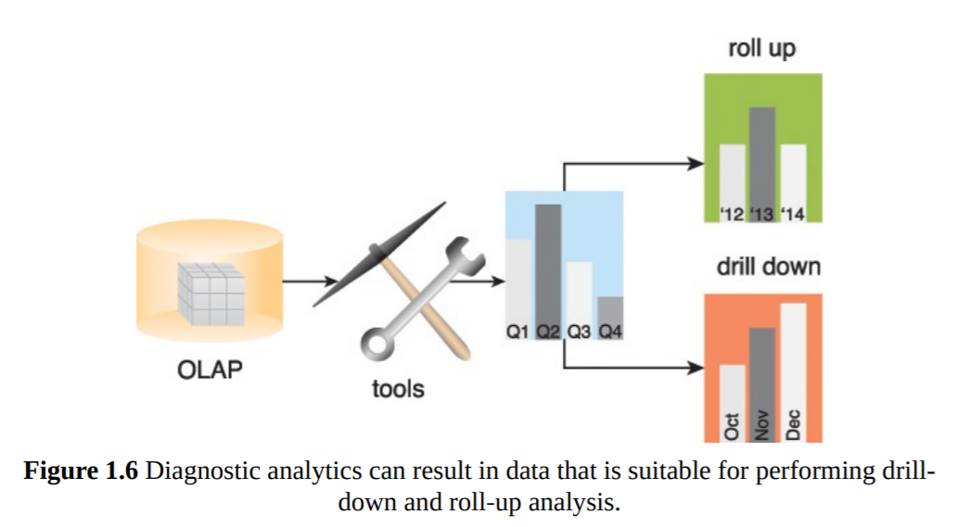
Diagnostic analytics usually require collecting data from multiple sources and storing it in a structure that lends itself to performing drill-down and roll-up analysis

Slide 26
Predictive analytics
Predictive analytics are carried out in an attempt to determine the outcome of an event that might occur in the future.
Questions are usually formulated using a what-if rationale, such as the following:
• What are the chances that a customer will default on a loan if they have missed a monthly payment?
• What will be the patient survival rate if Drug B is administered instead of Drug A?
• If a customer has purchased Products A and B, what are the chances that they will also purchase Product C?
Predictive analytics try to predict the outcomes of events, and predictions are made based on patterns, trends and exceptions found in historical and current data.

Slide 27
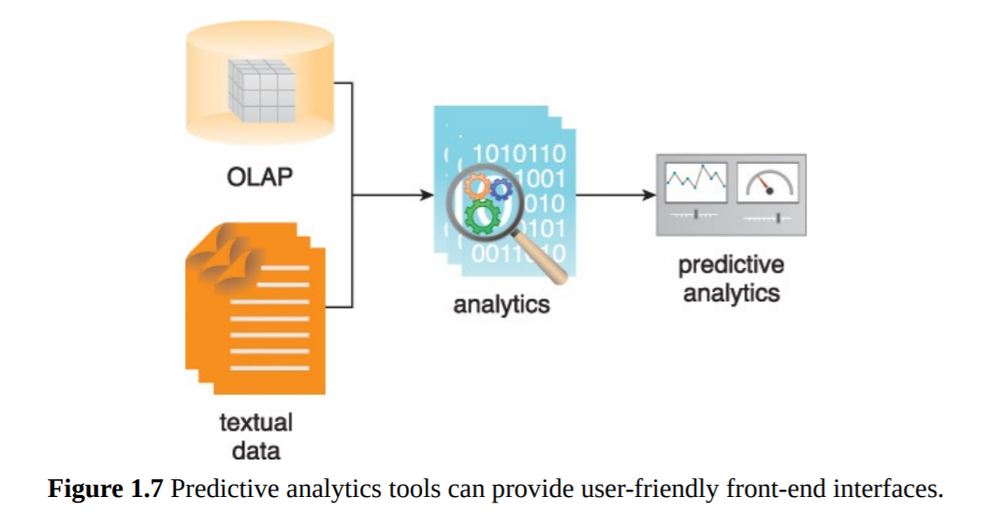

Slide 28
Prescriptive analytics
Prescriptive analytics build upon the results of predictive analytics by prescribing actions that should be taken.
Sample questions may include:
• Among three drugs, which one provides the best results?
• When is the best time to trade a particular stock?

Slide 29
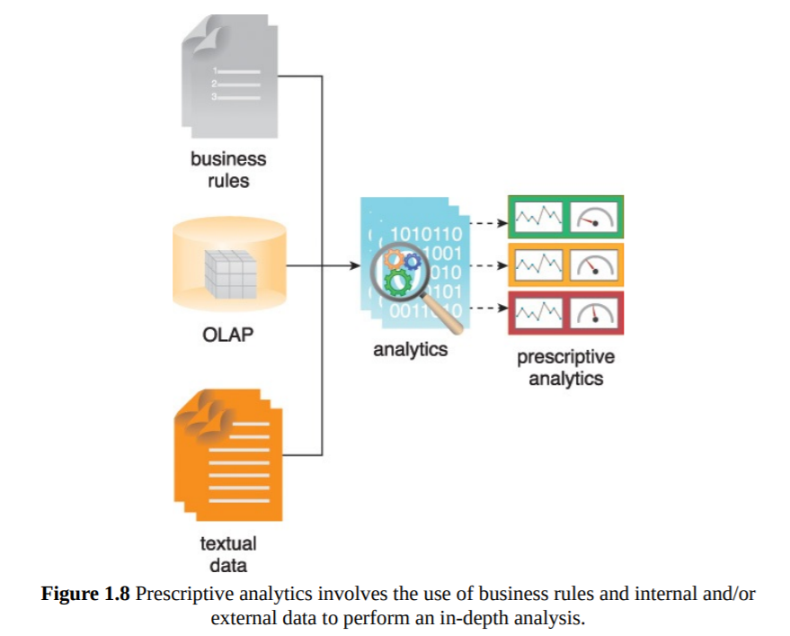
Prescriptive analytics involve the use of business rules and large amounts of internal and external data to simulate outcomes and prescribe the best course of action

Slide 30
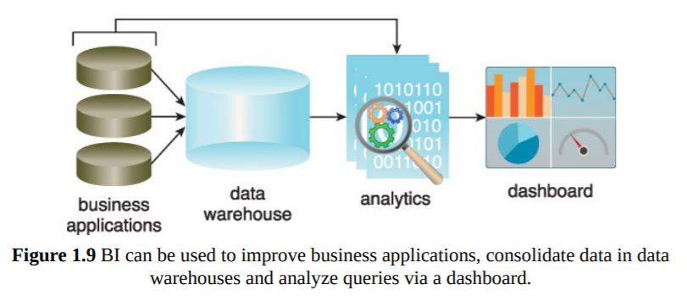
Business Intelligence (BI)
BI enables an organization to gain insight into the performance of an enterprise by analyzing data generated by its business processes and information systems.
BI applies analytics to large amounts of data across the enterprise, which has typically been consolidated into an enterprise data warehouse to run analytical queries.

Slide 31
Key Point Identifier
A KPI is a metric that can be used to gauge success within a particular business context. KPIs are linked with an enterprise’s overall strategic goals and objectives. They are often used to identify business performance
-quantifiable reference points for measuring a specific aspect of a business’ overall performanceproblems and demonstrate regulatory compliance.

Slide 32
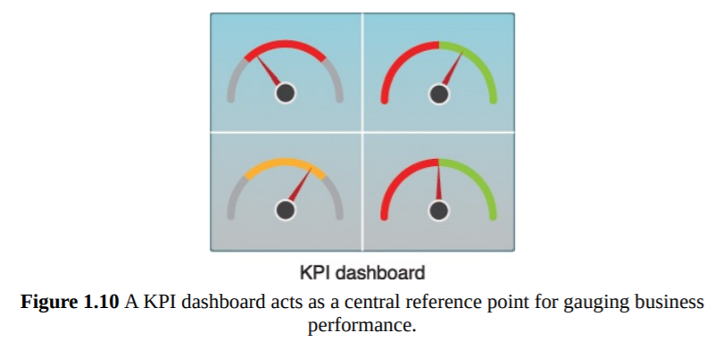
KPIs are often displayed via a KPI dashboard

Slide 33
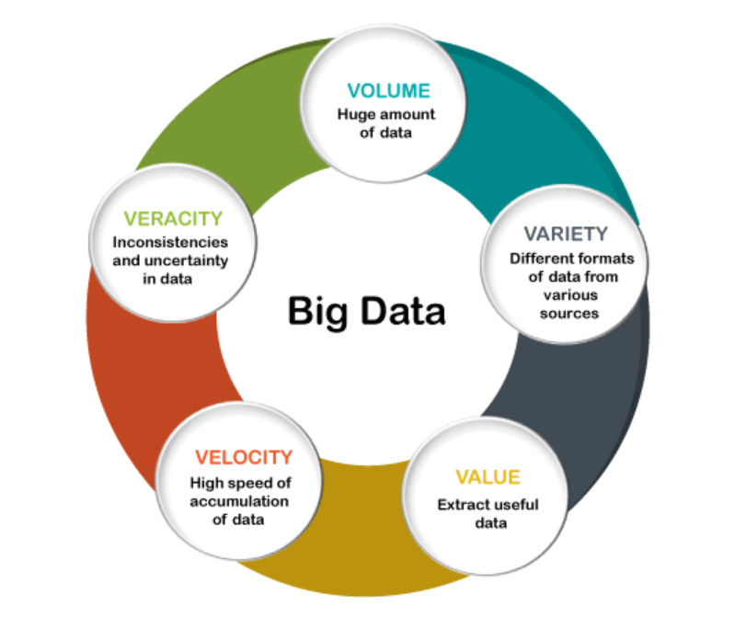
Big Data Characteristics(5 Vs)

Slide 34
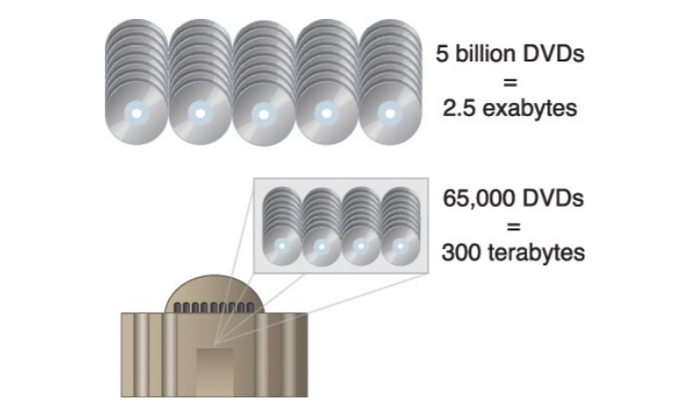
Volume

Slide 35
Typical data sources that are responsible for generating high data volumes can include:
• online transactions, such as point-of-sale and banking
• scientific and research experiments, such as the Large Hadron Collider and Atacama Large Millimeter/Submillimeter Array telescope
• sensors, such as GPS sensors, RFIDs, smart meters and telematics
• social media, such as Facebook and Twitter

Slide 36
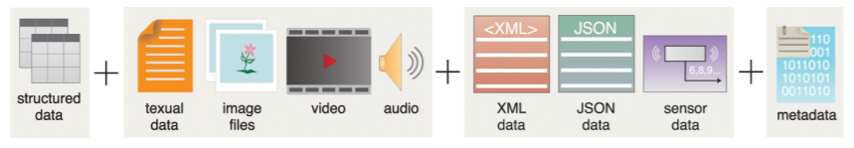
Variety

Slide 37
Structural variation of Data in action
In real time scenario, the data we found can be broadly categorize in the basis of its form:
Structured data: conforms to a data model or schema and is often stored in tabular form.
Ex: SQL Table in DBMS
Unstructured Data : Data that does not conform to a data model or data schema is known as unstructured data
Ex: Image, Video, Audio etc.
Semi-structured Data: Semi-structured data has a defined level of structure and consistency, but is not relational in nature
Ex: XML, JSON files, Sensor Data etc.

Slide 38
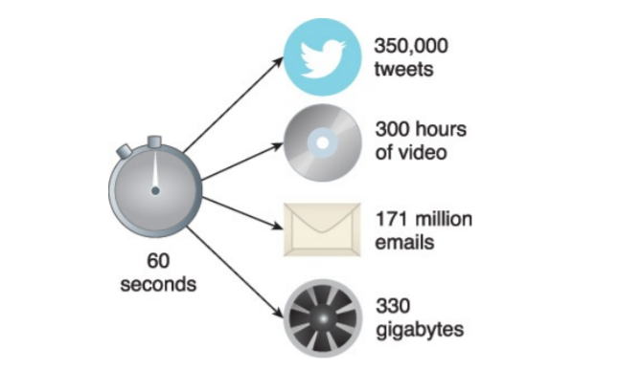
Velocity

Slide 39
Veracity
Veracity refers to the quality or fidelity of data.

Slide 40
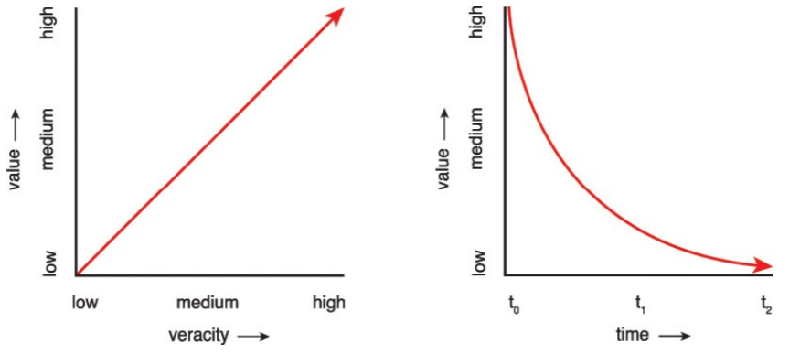
Value
Value is defined as the usefulness of data for an enterprise.
The higher the data fidelity, the more value it holds for the business
Value is also dependent on how long data processing takes

Slide 41
Apart from veracity and time, value is also impacted by the following lifecycle-related concerns:
• How well has the data been stored?
• Were valuable attributes of the data removed during data cleansing?
• Are the right types of questions being asked during data analysis?
• Are the results of the analysis being accurately communicated to the appropriate decision-makers?

Slide 42
Metadata: Metadata provides information about a dataset’s characteristics and structure.
Data About data.
Examples of metadata include:
• XML tags providing the author and creation date of a document
• attributes providing the file size and resolution of a digital photograph
Big Data solutions rely on metadata, particularly when processing semi-structured and unstructured data.

Slide 43
Quick Quiz
Data which describes another da is known as:
Data Analysis
Data Science
Metadata
Kafka

Slide 44
If you have more quriocity you may ask OR follow the following links:
https://www.tutorialspoint.com/big_data_tutorials.htm
https://www.analyticsvidhya.com/blog/2021/05/what-is-big-data-introduction-uses-and-applications/
https://www.coursera.org/learn/big-data-introduction
https://energie.labs.fhv.at/~repe/bigdata/introduction-to-big-data-projects/introduction-to-big-data/
https://intellipaat.com/blog/tutorial/big-data-and-hadoop-tutorial/introduction-to-big-data-2/
https://www.javatpoint.com/what-is-big-data
And many more…

Slide 45


